Slide 1


VA|CMS Application Preview
March 7th, 2018
Submitted to
Office of Construction & Facilities Management
By
MAX.gov, Mitchell Jarrett

Slide 2

VA|CMS Application Preview
Proposed VA|CMS User Roles
• Public User
• Authenticated User
• Consultant
• Subject Matter Expert
• Publisher

Slide 3
VA|CMS Application Preview
Public
An anonymous user who has access to publicly available data OUTSIDE the MAX firewall
Abilities a Public User has that an Authenticated User does not:
NONE
Abilities a Public User has that a Consultant does not:
NONE
Abilities a Public User has that a Subject Matter Expert does not:
NONE
Abilities a Public User has that a Publisher does not:
NONE

Slide 4
VA|CMS Application Preview
Authenticated User
An authenticated MAX ID user who has access to view data INSIDE the MAX firewall.
Abilities an Authenticated User has that a Public User does not:
This user can favorite items
This user can save queries
Abilities an Authenticated User has that a Consultant does not:
NONE
Abilities an Authenticated User has that a Subject Matter Expert does not:
NONE
Abilities an Authenticated User has that a Publisher does not:
NONE

Slide 5
VA|CMS Application Preview
Consultant
an authenticated MAX ID user who has access to view data INSIDE the MAX firewall; create new data; or edit existing data
Abilities a Consultant has that a Public User does not:
This user can favorite items
This user can save queries
This user can add new room codes
This user can edit existing room codes
Abilities a Consultant has that an Authenticated User does not:
This user can add new room codes
This user can edit existing room codes
Abilities a Consultant has that a Subject Matter Expert does not:
NONE
Abilities a Consultant has that a Publisher does not:
NONE

Slide 6
VA|CMS Application Preview
Subject Matter Expert
an authenticated MAX ID user who has access to view data INSIDE the MAX firewall; create new data; edit existing data; and approve the validity of entered data
Abilities a Subject Matter Expert has that a Public User does not:
This user can favorite items
This user can save queries
This user can add new room codes
This user can edit existing room codes
This user has the final say if room code information is correct
This user forwards added codes to the Publisher for publication.
This user forwards edited codes to the Publisher for publication.
Abilities a Subject Matter Expert has that an Authenticated User does not:
This user can add new room codes
This user can edit existing room codes
This user has the final say if room code information is correct
This user forwards added codes to the Publisher for publication.
This user forwards edited codes to the Publisher for publication.
Abilities a Subject Matter Expert has that a Consultant does not:
This user has the final say if room code information is correct
This user forwards added codes to the Publisher for publication.
This user forwards edited codes to the Publisher for publication.
Abilities a Subject Matter Expert has that a Publisher does not:
NONE

Slide 7
VA|CMS Application Preview
Publisher
an authenticated MAX ID user who has access to view data INSIDE the MAX firewall; create new data; edit existing data; and publish
validated data.
Abilities a Publisher has that a Public User does not:
This user can favorite items & save queries
This user can add and edit existing new room codes
This user can queue updated data for publication
This user can queue added data for publication
This user can publish updated data
This user can publish added data
This user can grant access to VA|CMS to any authenticated MAX ID This user can assign user roles
Abilities a Publisher has that an Authenticated User does not:
This user can add and edit existing new room codes
This user can queue updated data for publication
This user can queue added data for publication
This user can publish updated data
This user can publish added data
This user can grant access to VA|CMS to any authenticated MAX ID This user can assign user roles
Abilities a Publisher has that an Consultant does not:
This user can queue updated data for publication
This user can queue added data for publication
This user can publish updated data
This user can publish added data
This user can grant access to VA|CMS to any authenticated MAX ID This user can assign user roles
Abilities a Publisher has that an Subject Matter Expert does not:
This user can queue updated data for publication
This user can queue added data for publication
This user can publish updated data
This user can publish added data
This user can grant access to VA|CMS to any authenticated MAX ID This user can assign user roles

Slide 8
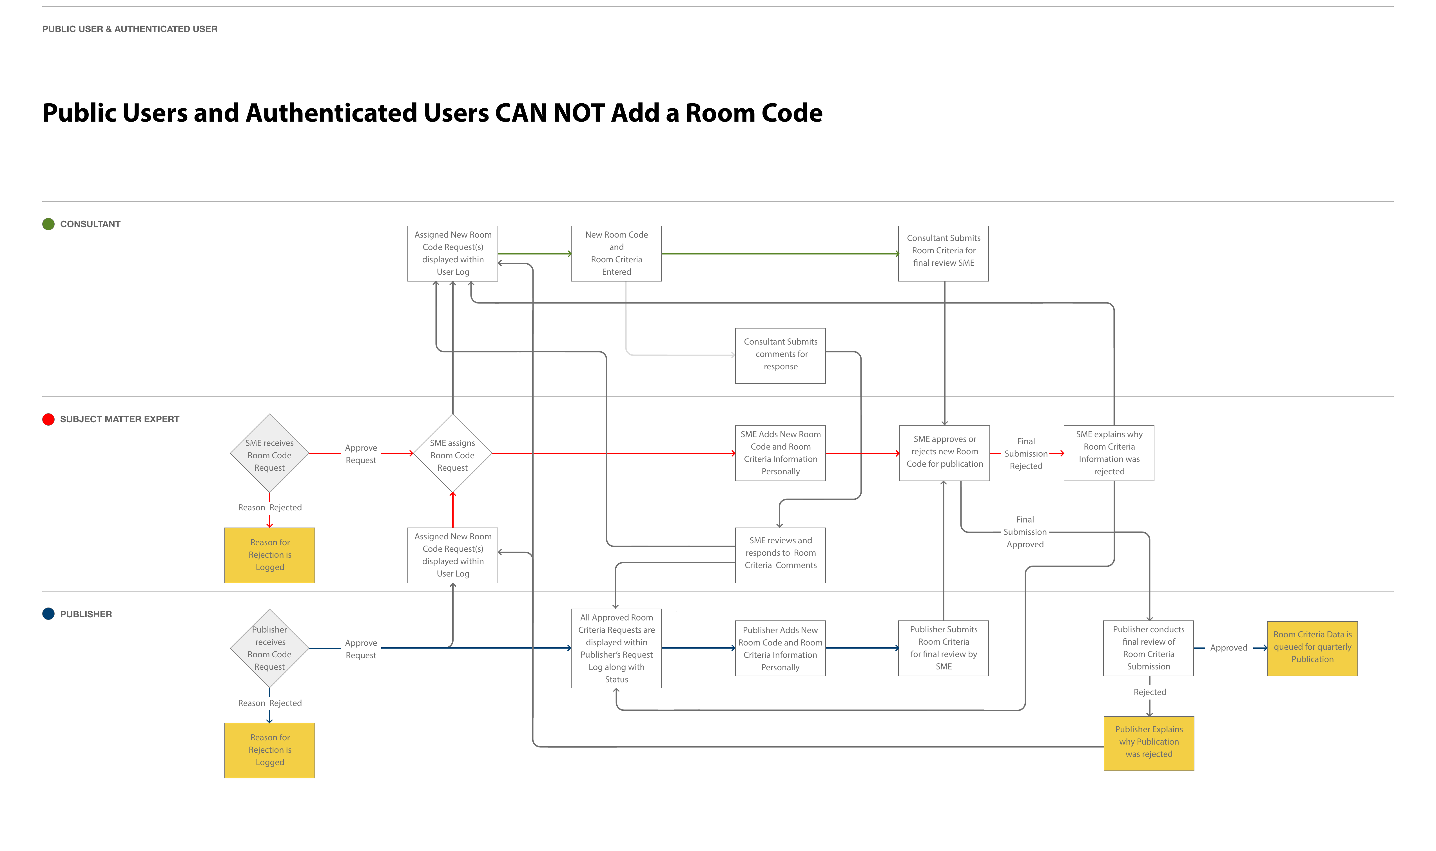
VA|CMS Application Preview
Workflow
Diagram
for Adding
a Room
Code

Slide 9
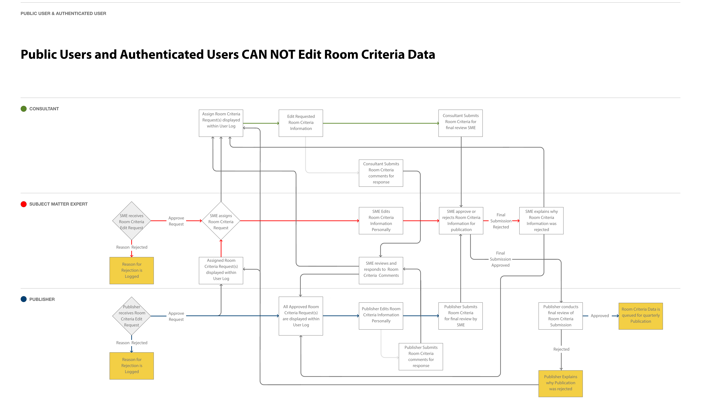
VA|CMS Application Preview
Workflow
Diagram
for Editing
Room Criteria
Data

